Slide 1
Olympic Data Analysis
Group 8
Shrilekha Vijayakanthan
Ameya Ganchha
Shruti Jadhav
Maithri Mathew

Slide 2
Motivation & Summary
Motivation
We initially wanted to analyze COVID-19 data
After realizing we were no subject experts, we moved on to something that was postponed due to quarantine
Olympics!
Questions
Do athletes have to be the same age to find success?
Do the olympics favor a certain BMI ?
Does a country’s GDP & Population affect the performance of its athletes?
Have the number of events changed throughout history?
Does Weight and Height of the Players play a Key role in Medal Wining
Does location affect the medal count of countries
Summary
We were able to answer all of our questions- However, we had to tweak the parameters and ways we went about testing our hypothesis

Slide 3
Data Sources
Kaggle
https://www.kaggle.com/heesoo37/120-years-of-olympic-history-athletes-and-results#athlete_events.csv
https://ourworldindata.org/

Slide 4
Questions & Data
Because the data source was comprehensive and had the parameters we were assessing, we did not require any additional merging of external CVSs
The questions we asked required analyses of trends- to answer them we utilized different visualization plots
line graphs
bar graphs
scatter plots with linear regression
heat maps

Slide 5
Data Cleanup & Exploration
Key functions used in sorting our data
Group by
Dictionaries
Len, .sum(), .mean()
.dropna
plt.tight_layout()

Slide 6
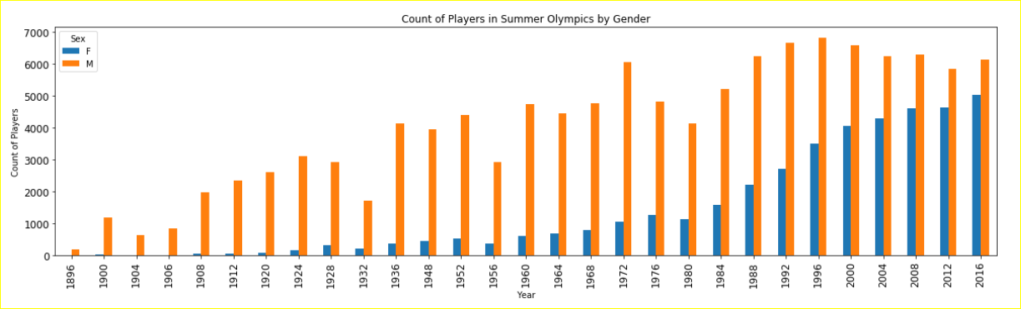
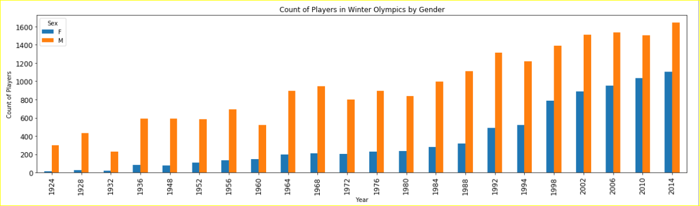
Gender Distribution
-
-
Gradual Increase in Female players over the years in both Summer and Winter Olympics .As of 2016 we have 6223 Female Players and 7465 Males players

Slide 7
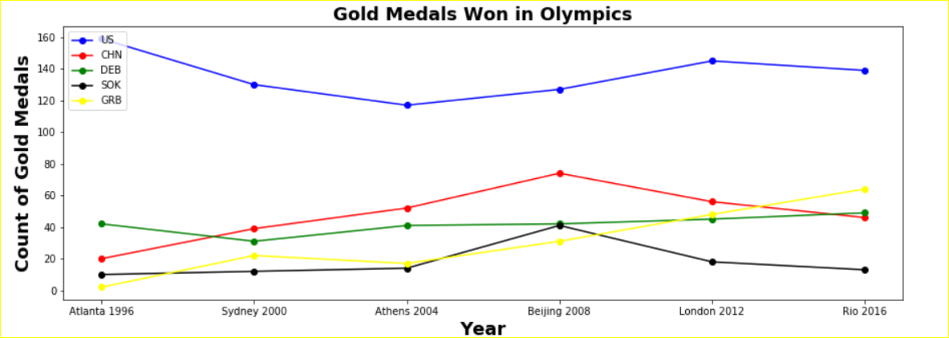
Top 5 Countries Medal Trend
US , China and UK had more medals when it was hosted in home country

Slide 8
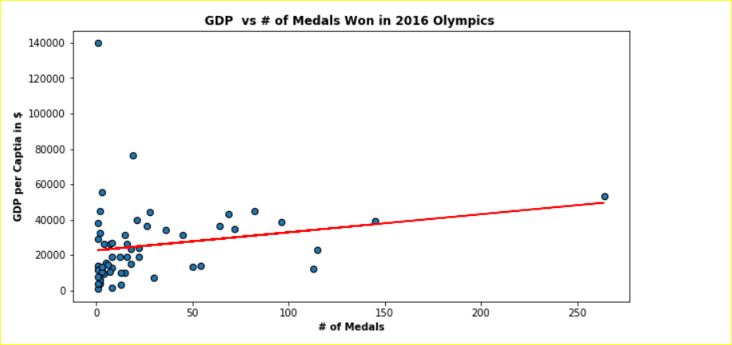
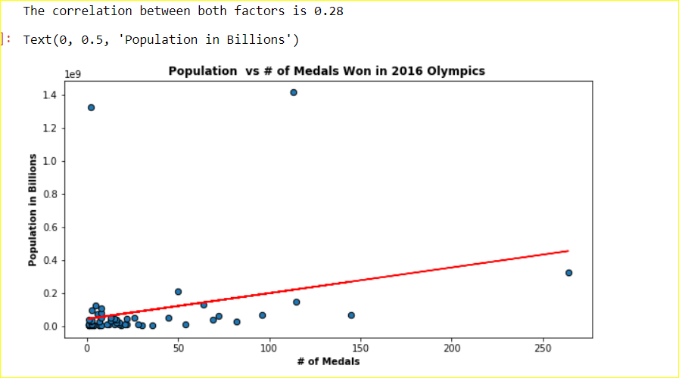
GDP and Population vs Medal Correlation
Both the Analysis shows moderate
Correlation but it shows not all the countries with higher GDP and Population are wining more medals.

Slide 9
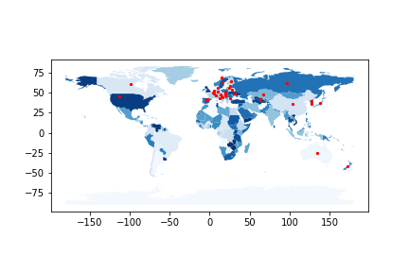
Medals by Country in Winter Olympics
Winter Olympics 1896 - 2016

Slide 10
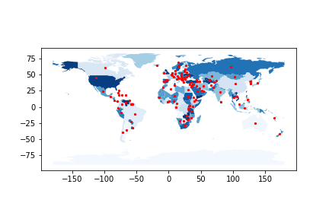
Medals by Country in Summer Olympics
Summer Olympics 1896 - 2016

Slide 11
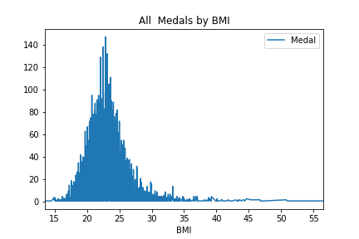
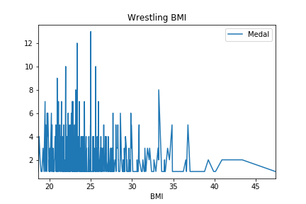
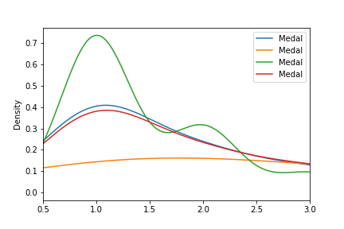
Medals by BMI

Slide 12
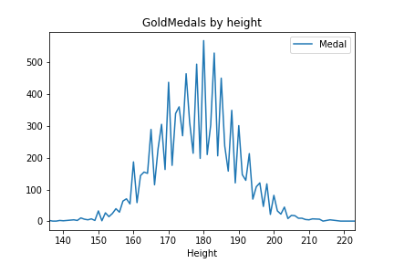
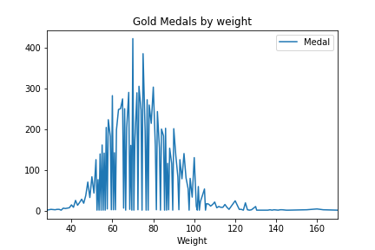
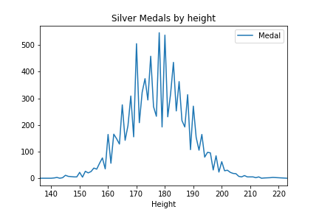
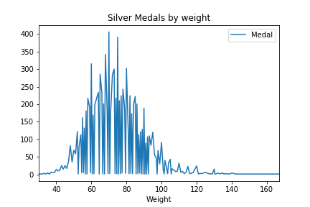
Medals by Height and Weight

Slide 13
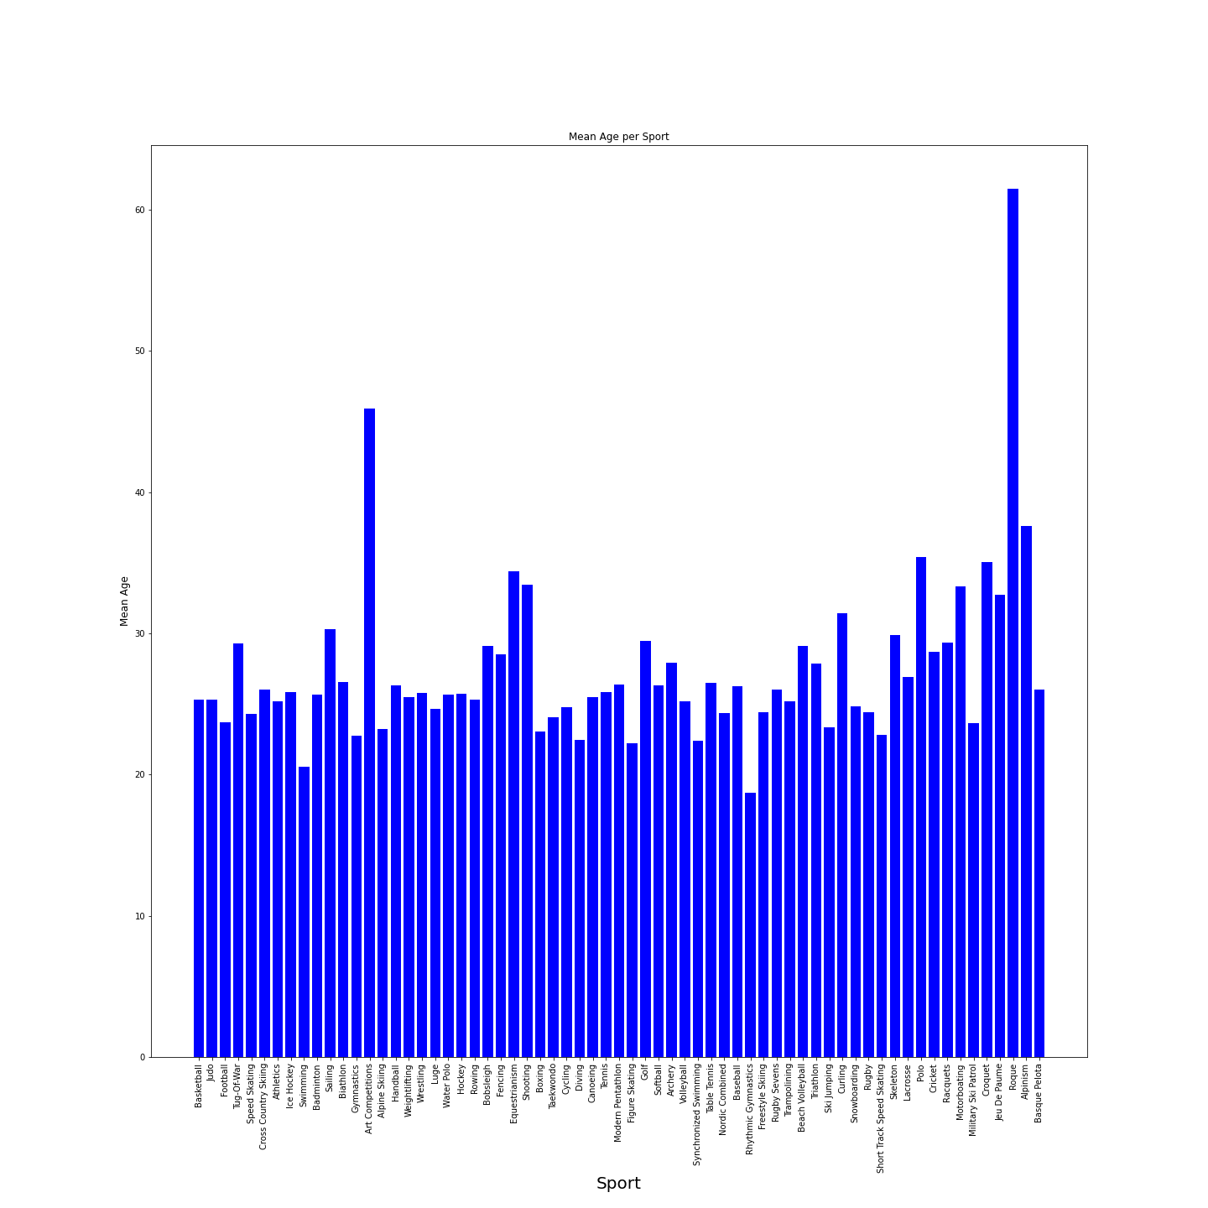
Maithri
Black
Is the color of coal, ebony, and of outer space. It is the darkest color, the result of the absence of or complete absorption of light.

Slide 14
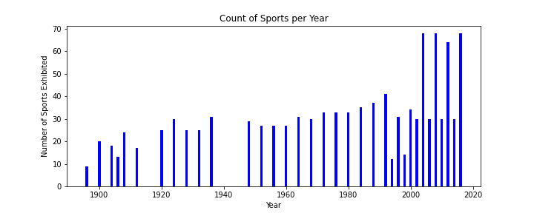

Slide 15
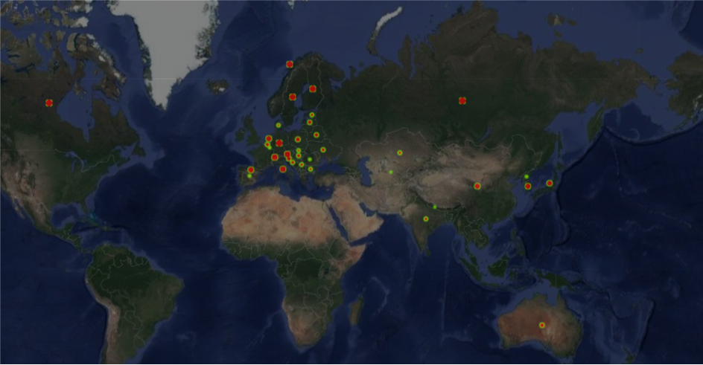
Medals Won by Country
Winter Olympics 1896 - 2016

Slide 16
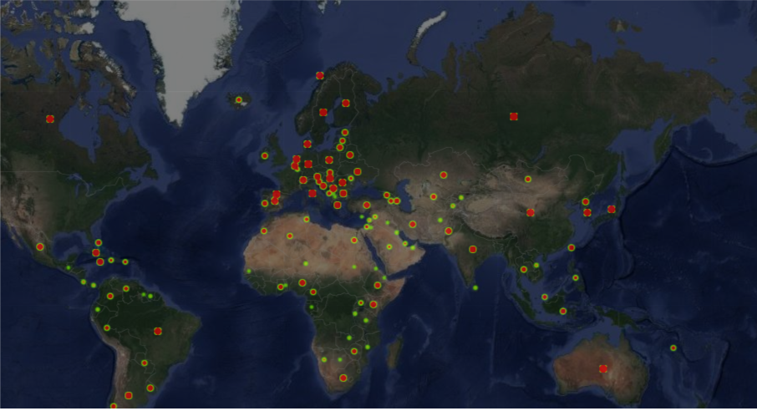
Medals Won by Country
Summer Olympics 1896 - 2016

Slide 17
Post Mortem
Method Conflict
Data manipulation and visualization can be difficult!
End Result isn't always visualized
Coding Desensitization
Method Conflict

Slide 18
Questions

